Slide 1

Cybervision Absent Traffic Detector
GVE DevNet
Global Sales Segment : Global Service Provider/ Global Enterprise/Global Public Sector/Global Commercial and Small
Industries : Cities and Communities/Education/Financial Services/Government/Health Care/Manufacturing/Oil and Gas/Retail/Transportation/Utilities
LoB : Safe and Security/Operations Automation/Operation Analytics
Architectural Plays : Enterprise/Security
Sales Plays : Enable Secure Access/Breach Defense/Modernize the Workforce Experience for Enterprise/Enable Secure Access for Enterprise/Other
Stien Vanderhallen, Roaa Alkhalaf
Technical Solutions Specialist
March 2022
Notes:
Notes: If your use case applies to morer than one or even all industries please keep all the industries and BOLD the industry where the PoV fits.
Smart City/Health Care/Industry and Manufacturing/Hospitality/Education/Retail/Utilities/Logistics/Professional Services/Public Sector/Service Provider
For LoB applies the same : if there is just one LoB, delete others, and bold the LoB that PoV is about.
LoB ; Safe and Security/Operations Automation/Human Resources/Operation Analytics
Please only keep the Architectural Plays that PoV is about.
Architectural Play : Enterprise / Data Center / Security / Collaboration / Service Provider

Slide 2
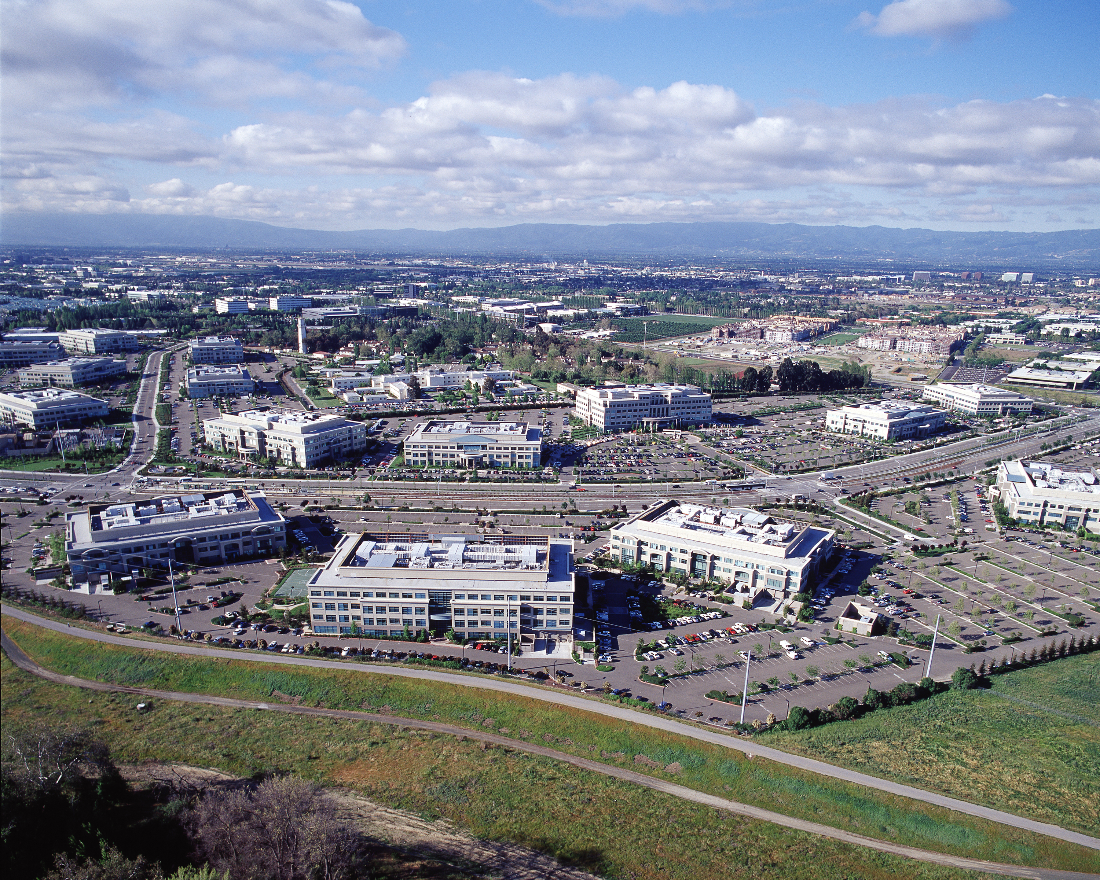
Security
Operations Automation
Notes:
Please under Industry Alignment just types the Industry that PoV was created as well LoB
For the pictures, when you go to the bx.cisco.com link and select brand categories and the select photograpy you can use the engine text box to look for industry pictures and download it

Slide 3

Cybervision Absent Traffic Detector
Business Needs/Challenges
Need: The customer uses Cisco Cybervision to secure their OT environment. However, they face operational challenges due to not reacting in a timely fashion to a subset of security threats.
Challenge: Cisco Cybervision does not flag traffic as anomalous when it was seen previously, but does not occur anymore.
Solution
The solution fetches traffic flow information from Cisco Cybervision, and marks traffic as anomalous when it was previously seen, but not anymore. The user can customize which traffic is flagged, based on how long ago it was last seen by Cybervision.
Business Outcomes
The customer can relieve operational challenges due to being better informed of the security threats in their OT infrastructure.
Notes:
Notes :
At the top Select a short name of the PoV naming product or products involved
Insert the logo f the customer when applies (if it is a general use case ignore the insert logo)
For Business Needs/Challenges :
For bullet Need : Write a small sentence that in an objective way to express the problem to solve when you refer to this problem, avoid to use technical words, uses business language as C-Level
For bullet Challenge : Write the main challenge and drawback the customer has to solve the problem (also avoid technical words, make a message in C-Level)
Solution :
Describe in a small sentence what is the solution about to deal with the problem referred, again, please avoid to uses technical words and use C-Level language
Business Outcomes:
Use small paragraph to show the benefits and gains with the solution explained above, please avoide to uses technical words and use C-Level language

Slide 4
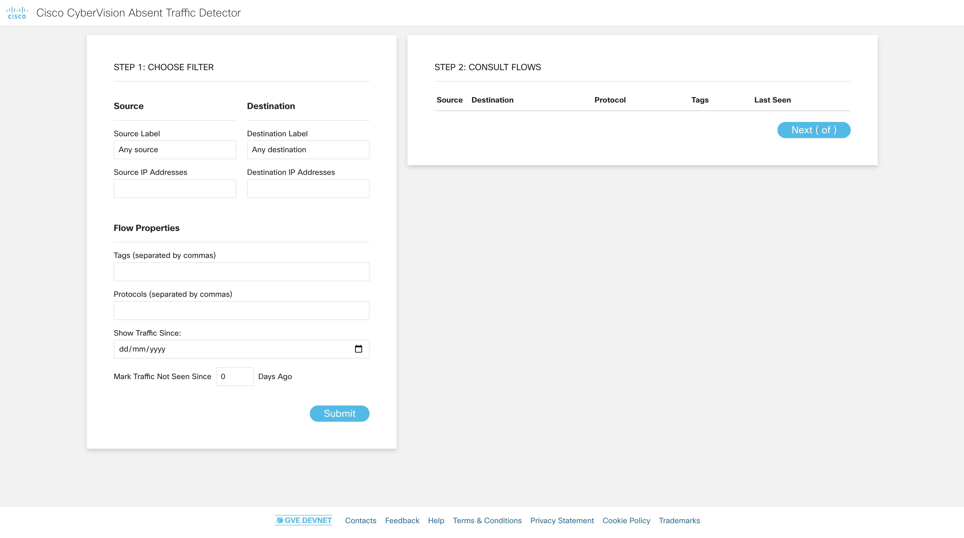
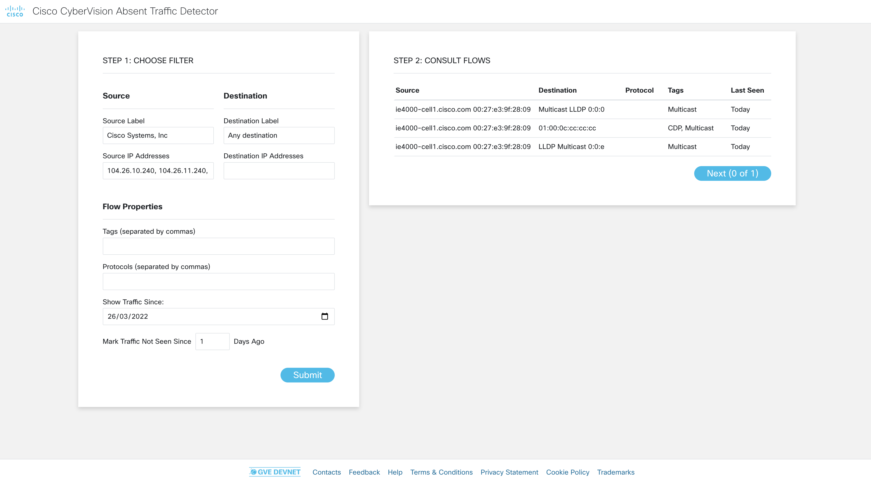

Cybervision Absent Traffic Detector
(1) The user filters results per source, destination, protocol, date and flow tags
(2) The tool shows corresponding traffic flows, flagged if anomalous
Notes:
Notes :
Use this slide to explain the story around your solution. It is a prototype in high level point of view. Think about a explanation of your solution to an executive that does not know Cisco and deep dive technology
This slide it is also to share knowledge with a non-technical guy (like BDM or sales or C-Level) what is the solution about and how will work . You can do as many steps as you need to describe the main flow of the solution
LINK for Icons https://www.flaticon.com/

Slide 5
Cybervision Absent Traffic Detector
Customer / Opportunity
Haribo is a large customer in Germany. They currently use Cisco Cybervision to secure their OT infrastructure.
What is the story? What was the business challenge?
Cybervision does not show traffic as being anomalous when it was seen previously, but not anymore. This poses operational challenges to Haribo, since they are not able to detect components in their networks going down.
What the PoV accomplished?
The PoV uses Cybervision APIs to gather a list of traffic flows seen over a certain period of time, and then gathers the traffic that went absent since a certain amount of time (specified by the PoV user).
What are the benefits to the customer?
The customer can now overcome their operational challenges faced by Cybervision’s limitations. They are now more likely to stick with the product as well as its benefits.
Notes:
Notes :
*** From the side to the rest you can use all technical wording and reference from Cisco APIs, integrations and tools
Please fill the slide thinking about technical people and the scope of this PoV (what it is cover from the solution proposed and if there is a limitation or need a special integration to be awared
Align the bullet
What are the benefits to the customer?
With the Business Outcomes that you explain in the business case slide. And also you can add technical benefits on this slide or future steps to be added later as following steps

Slide 6

High Level Design PoV
(1) The user filters results per source, destination, protocol, date and flow tags
(2) Tool communicates with Cybervision to gather traffic flows
(4) User consults results
(3) Tool filters flows based on user flows, and marks absent traffic
https://www.github.com/gve-sw/gve_devnet_cybervision_absent_traffic_detection
Notes:
Notes:
Describe the High level design and flow for the PoV and mentioned the tools used
Do not forget to add the link to github repository or other specifcs needs

Slide 7
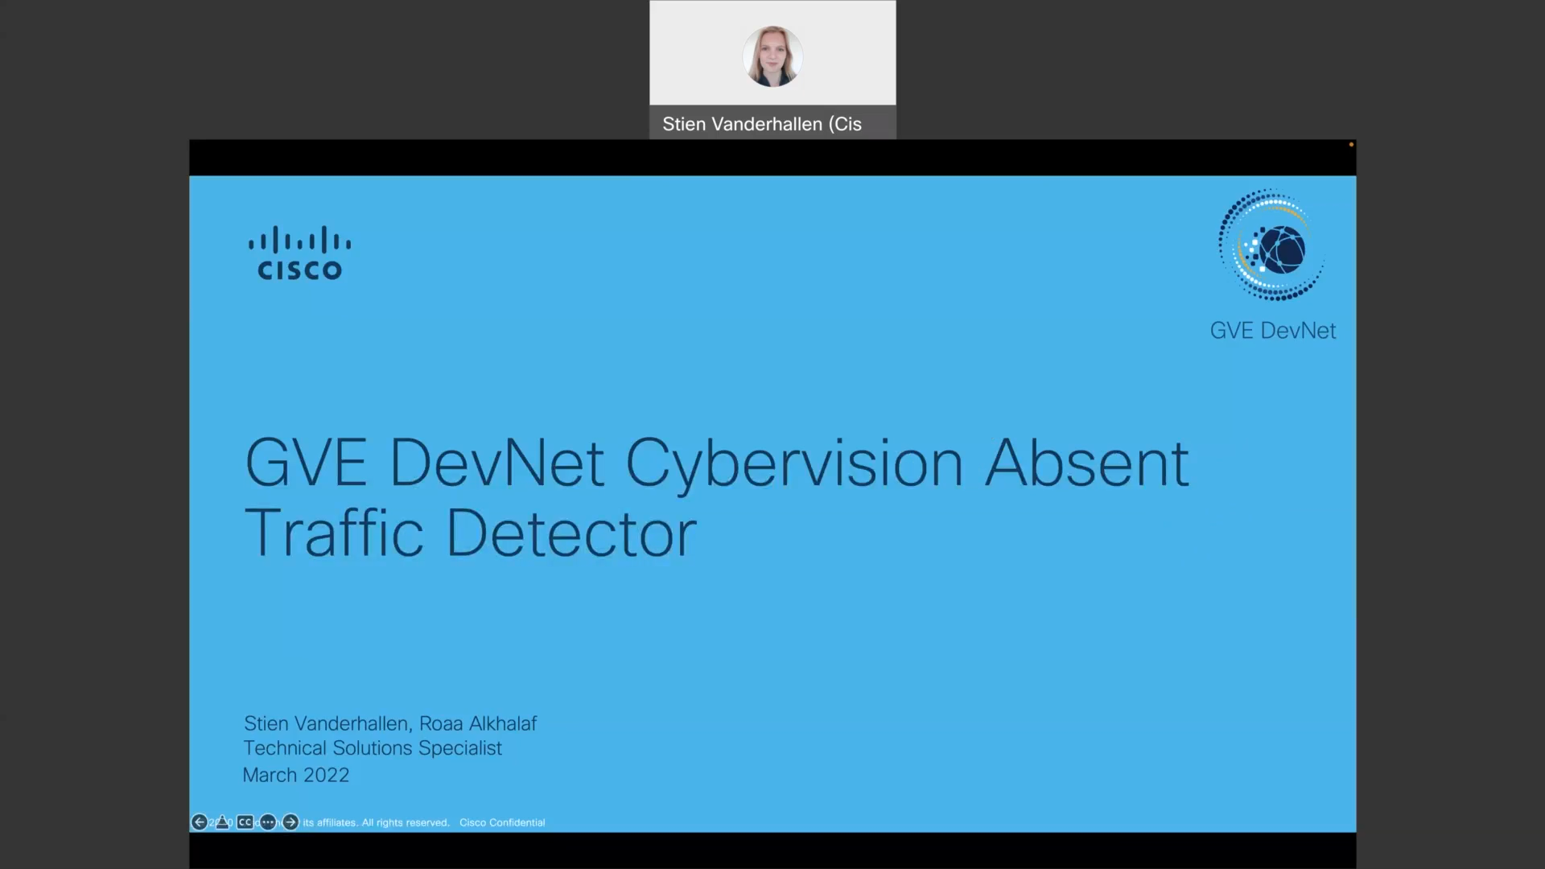
Show GUI or mockup
https://www.github.com/gve-sw/gve_devnet_cybervision_absent_traffic_detection/internaldocs/video.mov
Notes:
Notes :
Some of the PoVs are developed either Sandboxes from dcloud, devnet or customer premises lab.
In the case the PoV is execute under Customer Premises Lab and would be hard to replicate the PoV, Please record video with the Demo and add the link to it.

Slide 8
Tools (products) Used
Python, Flask, Cybervision, Cybervision REST API
https://www.github.com/gve-sw/gve_devnet_cybervision_absent_traffic_detection/internaldocs/GVE_Devnet_Cybervision_Absent_Traffic_Detector.pptx
Notes:
Notes :
Describe all the tools,
If there is a need for a specific licenses or code versión or hardware specifications mentioned here

Slide 9
Check out the GVE Devnet team @
https://gve-devnet.cisco.com/
Open a GVE case @
https://cep.cloudapps.cisco.com/case

